Slide 1
COVID-19 ICU Admissions

Slide 2
Agenda
Problem Overview
Data Trends
Predictive Modeling
Model Justification

Slide 3
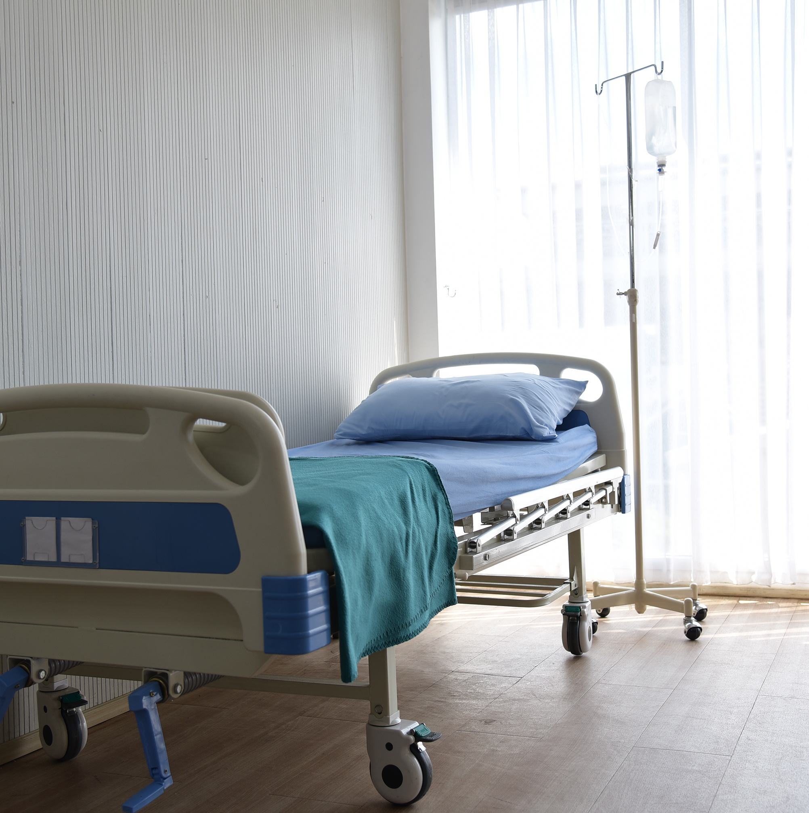
Problem Overview
Predicting COVID-19 ICU Admissions

Slide 4
Tasks At Hand
1. Predict admission to ICU of confirmed COVID-19 Cases
Is it feasible to predict which patients will need ICU support? Why?
The goal is to provide tertiary & quarternary hospitals with the most accurate answer so ICU resources can be arranged or patient transfer can be scheduled.
2. Predict NOT admission to the ICU of confirmed COVID-19 cases
Is it feasible to predict which patients will NOT need ICU support? Why?
To provide local & temporary hospitals a good enough answer so frontline physicians can safely discharge and remotely follow up with these patients.

Slide 5

Trends in the Data
Dataset from Hospital Sao Paulo and Brasilia
All anonymized
All scaled between -1 and 1
Breakdown of Data:
Patient Demographic Info (3)
Patient Previous Grouped Diseases (6)
Blood results (36)*
Vital Signs (6)*
* Each of these is expanded to show minimum, maximum, mean, median, difference, and relative difference calculations.
Notes:
Explain what the scaled values mean

Slide 6

Patient Demographics

Slide 7
First ICU Admissions

Slide 8
Explore a Patient Profile

Slide 9
No Vitals or Bloodwork Taken

Slide 10
Predictive Models
(Let’s get to the gist of the techy stuff)
This is the code behind building the machine learning models (double-click to open)
Notes:
Here, explain what predictive modeling is.

Slide 11
Model Evaluation
Model | Accuracy
Logistic Regression | 97.2%
Decision Tree Classifier | 94.1%
Random Forest | 96.5%
Support Vector Machines | 86.8%
Naïve Bayes | 94.1%
Notes:
Talk about the purpose of each model briefly, and highlight the 2 with the highest accuracy scores.

Slide 12
Key Influencers
Notes:
Based on vital signs, these are the most influential figures on the likelihood of ICU admittance.

Slide 13
Final Takeaways
Why use this model?
Strong precision, recall, and f1-scores = high predictive capabilities
Can provide data points as markers for likelihood of ICU admittance (or non-admittance)
Load & analyze data specific to your city/region/hospital
Keep up with changes in patient vital signs

Slide 14
Thank you

